Slide 1

Object Oriented Programming with Java (Subject Code: BCS-403)
Unit 2
Lecture 18

Slide 2
Lecture 18
Thread
Thread Life Cycle

Slide 3
Multithreading in Java
Multithreading in java is a process of executing multiple threads simultaneously.
Thread is basically a lightweight sub-process, a smallest unit of processing. Multiprocessing and multithreading, both are used to achieve multitasking.
Java Multithreading is mostly used in games, animation etc.

Slide 4
Advantages of Java Multithreading
1) It doesn't block the user because threads are independent and you can perform multiple operations at same time.
2) You can perform many operations together so it saves time.
3) Threads are independent so it doesn't affect other threads if exception occur in a single thread.

Slide 5
What is Thread in java
A thread is a lightweight sub process, a smallest unit of processing. It is a separate path of execution.
Threads are independent, if there occurs exception in one thread, it doesn't affect other threads. It shares a common memory area.
Note: At a time one thread is executed only.

Slide 6
Life cycle of a Thread (Thread States)
The life cycle of the thread in java is controlled by JVM. The java thread states are as follows:
New
Runnable
Running
Non-Runnable (Blocked)
Terminated

Slide 7
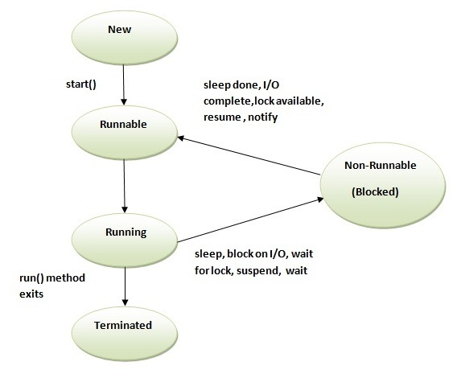

Slide 8
1) New
The thread is in new state if you create an instance of Thread class but before the invocation of start() method.
2) Runnable
The thread is in runnable state after invocation of start() method, but the thread scheduler has not selected it to be the running thread.
3) Running
The thread is in running state if the thread scheduler has selected it.
4) Non-Runnable (Blocked)
This is the state when the thread is still alive, but is currently not eligible to run.
5) Terminated
A thread is in terminated or dead state when its run() method exits.

